Slide 1

Basics Of Quality
By
Dr. Priyabrata Mohapatra

Slide 2
Introduction
Two major factors of success in any organization are market demand & profitability.
Factors influencing the competitive edge of a company are the unit cost, product quality and lead time.
Best approach of product quality is to build quality into the product and process right at the process & product design stage.
Quality may also be improved at the production stage by using statistical process control technique

Slide 3
What is Quality
A product or service of good quality if it meets the needs and expectations of customer.
According to Dr. W.R.Spriegel , “ The quality of a product may be defined as the sum of a number of related characteristics such as shape, dimension, composition, strength, workmanship, adjustment, finish and color.”

Slide 4
Quality can be expressed as a ratio:
Quality = P/E
P: Performance and Result
E: Expectations of customers

Slide 5
Two aspects of quality:
features: more features that meet customer needs = higher quality
freedom from trouble: fewer defects = higher quality

Slide 6
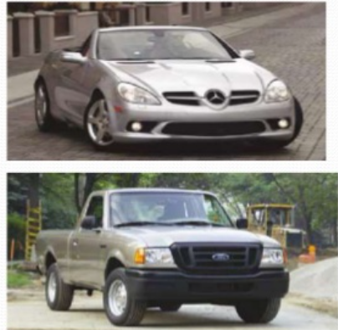
Quality As customer Perspective
Fitness for Use
How well product or service
does what it supposed to do
Quality Design
Design quality characteristics
into a product or service
A Mercedes or A Ford are equally fit for use but with different design dimensions

Slide 7
Introduction
Q— Quest for excellence
U—Understanding for Customer need
A—Action to achieve customer Appreciation
L— Leadership Determination to be leader
I— Involving all people
T—Team spirit to work for common goal
Y—Yard stick to measure process

Slide 8
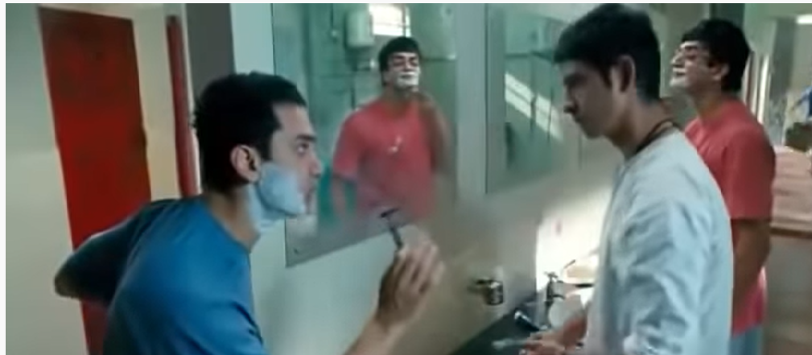
Quest for excellence

Slide 9
Customer need
What is their identity with the brands?
What are the preferred Channel?
What does the personnel value that influences their decision ?
What does the Customer Want?
What are the topic that matter?
What drives their behavior most?
What are the key traits of their influence?
What message stimulates them to desired action?

Slide 10
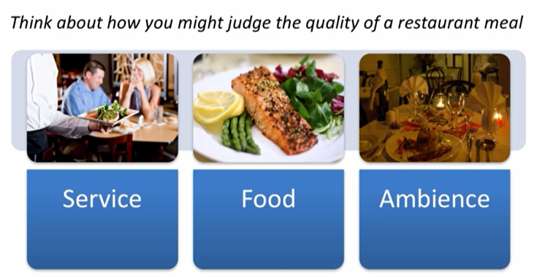
Quality closely linked with customer service

Slide 11
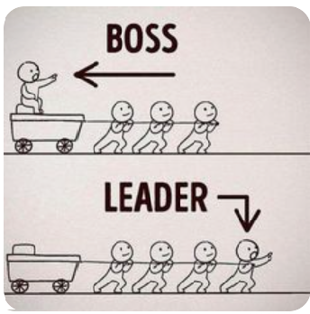

Leadership

Slide 12

Team Work

Slide 13


Slide 14
Yard stick to measure process
To measure the performance

Slide 15
Quality is not just about product-it include whole customer satisfaction
Product reliability
Buying processes
QUALITY
Cost of Ownership
After sale service

Slide 16
Quality Dimensions
Performance
Features
Reliability
Conformance
Durability
Serviceability
Aesthetics
Perceived Quality

Slide 17
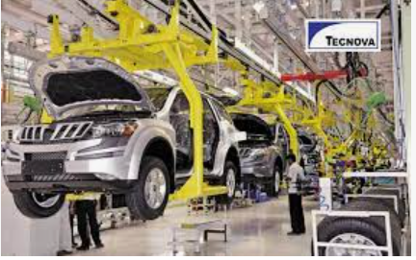

Performance
For Automobile Industry, performance depends like acceleration, handling, cruising, speed, Comfort
For TV, performance like Clarity, colour, sound

Slide 18
For Service business say Fast food and Airline performance means promote service
A 100-watt light bulb provides greater candlepower than a 60-watt bulb, yet few customers would regard the difference as a measure of quality. The bulbs simply belong to different performance classes.
So the question of whether performance differences are quality differences may depend on circumstantial preferences-but preferences based on functional requirements, not taste.

Slide 19
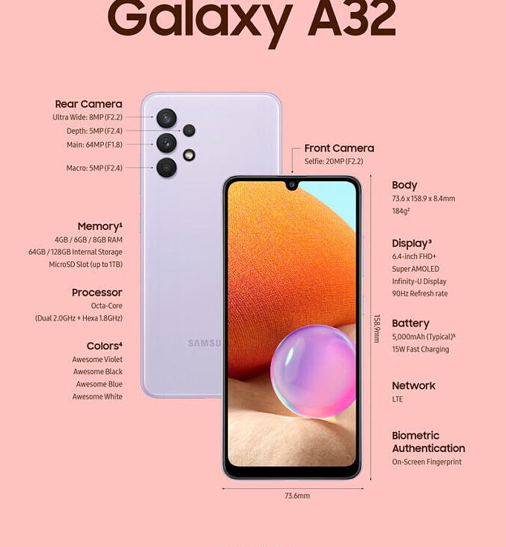
Features
Features are Bells and Whistles of the product and service

Slide 20
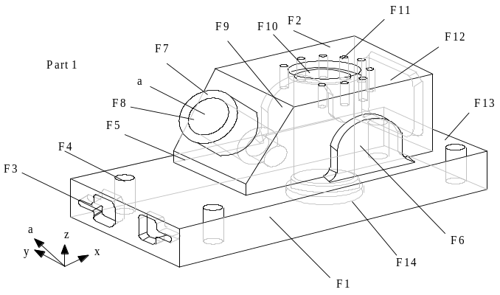
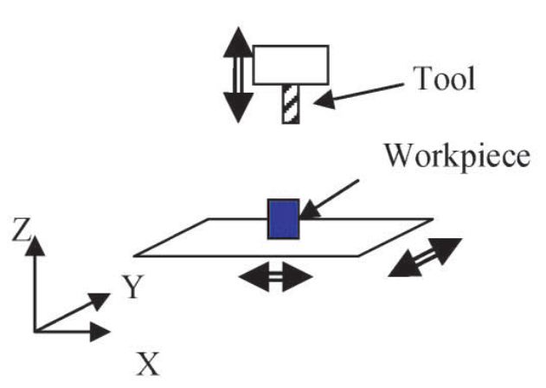
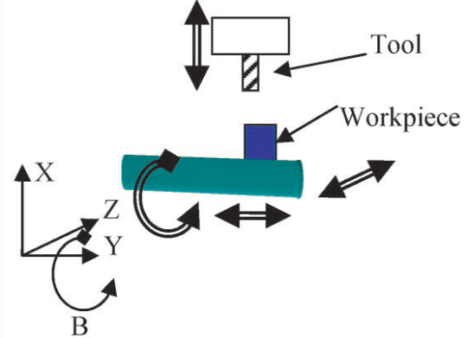
Features identification
Characteristics of machining features
Feature ID | Feature descriptions | Operations | Tool access directions | Machining time(UT)
F₁ | Planner surface | Milling | (0, 1, 0) | 1
F₂ | Planner surface | Milling | (0, 0, -1) | 1
F₃ | Two pockets arranged as a replicated feature | Milling | (1, 0, 0) | 1
F₄ | Four holes arranged as a replicated feature | Drilling | (1, 0, -1) | 1
F₅ | Step | Milling | (1, 0, 0) | 1
F₆ | Protrusion (rib) | Milling | (0, 1, 0) | 1
F₇ | Boss | Milling | (cos 45, 0, -sin45) | 1
F₈ | Compound hole | Drilling Reaming Boring | (cos 45, 0, -sin45) | 1
F₉ | Protrusion (rib) | Milling | (0, -1, 0) | 1
F₁₀ | Compound hole | Drilling Reaming Boring | (0, 0, -1) | 1
F₁₁ | Nine holes arranged in a replicated feature | Drilling Tapping | (0, 0, -1) | 1
F₁₂ | Pocket | Milling | (-1, 0, 0) | 1
F₁₃ | step | Milling | (-1, 0, 0) | 1
F₁₄ | Compound hole | Reaming Boring | (0, 0, 1) | 1
Machine Configuration
3-axis Machine
4-axis Machine

Slide 21
Reliability
The probability of a product malfunctioning or failing within a specified time period.
Among the most common measures of reliability are the mean time to first failure, the mean time between failures, and the failure rate per unit time.
Because these measures require a product to be in use for a specified period, they are more relevant to durable goods than to products and services that are consumed instantly.

Slide 22
Conformance :
Conformance, or the degree to which a product’s design and operating characteristics meet established standards.
For Example: For a part, it is whether this part is right size
For a Restaurant, it is whether food is cooked as per your request
One drawback of this approach is the problem of “tolerance stack-up”: when two or more parts are to be fit together, the size of their tolerances often determines how well they will match
To address this problem, a more imaginative approach to conformance has emerged.

Slide 23
It is closely associated with Japanese manufacturers and the work of Genichi Taguchi, a prizewinning Japanese statistician. Taguchi begins with the idea of “loss function,” a measure of losses from the time a product is shipped
These losses include warranty costs, nonrepeating customers, and other problems resulting from performance failure.
Taguchi then compares such losses to two alternative approaches to quality: on the one hand, simple conformance to specifications, and on the other, a measure of the degree to which parts or products diverge from the ideal target or center.

Slide 24
He demonstrates that “tolerance stack-up” will be worse—more costly—when the dimensions of parts are more distant from the center than when they cluster around it, even if some parts fall outside the tolerance band entirely.
According to Taguchi’s approach, production process 1 in the Exhibit is better even though some items fall beyond specification limits. Traditional approaches favor production process 2. The challenge for quality managers is obvious.

Slide 25
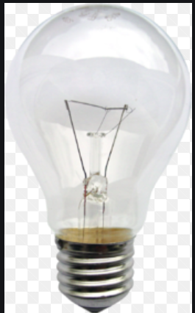

Durability
A measure of product life, durability has both economic and technical dimensions
Technically, durability can be defined as the amount of use one gets from a product before it deteriorates.
After so many hours of use, the filament of a light bulb burns up and the bulb must be replaced

Slide 26
One-hoss shays---Repair is impossible
Consumers must weigh the expected cost, in both dollars and personal inconvenience
Durability, then, may be defined as the amount of use one gets from a product before it breaks down and replacement is preferable to continued repair.

Slide 27

Serviceability
Caterpillar guarantees delivery of repair parts anywhere in the world within 48 hours; a competitor offers the free loan of farm equipment during critical periods should its customers’ machines break down.
General Electric, Pillsbury, Procter & Gamble, Polaroid, Whirlpool, Johnson & Johnson, and other companies have sought to preempt consumer dissatisfaction by installing toll-free telephone hot lines to their customer relations departments.

Slide 28
Aesthetics
Aesthetics—how a product looks, feels, sounds, tastes, or smells—is clearly a matter of personal judgment and a reflection of individual preference

Slide 29
Perceived Quality
Reputation is the primary stuff of perceived quality
In the early 1980s, Maytag introduced a new line of dishwashers. Needless to say, salespeople immediately emphasized the product’s reliability—not yet proven—because of the reputation of Maytag’s clothes washers and dryers

Slide 30
Consumers do not always have complete information about a product’s or service’s attributes; indirect measures may be their only basis for comparing brands.

Slide 31
Example

Slide 32
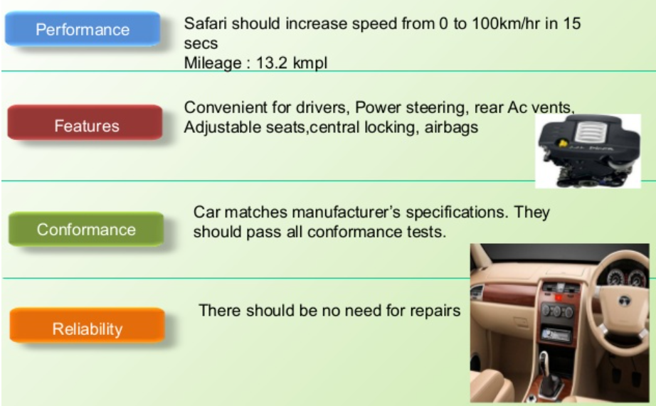

Slide 33
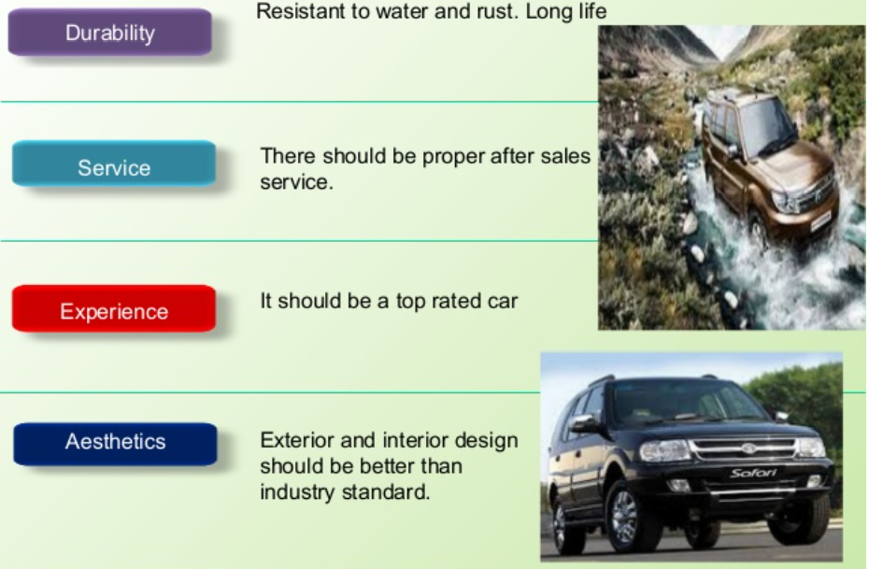

Slide 34
Example of Dimensions of Quality
Dimension | Product Example Laser Printer | Service Example Checking Account at a Bank
Performance | Pages per minute, Print density | Time to process customer request
Features | Multiple paper trays Colour Capability | Automatic bill paying
Reliability/Durability | Mean time between failures Estimated time to obsolescence Expected life of major companies | Variability of time to process request Keeping Pace with industry trends
Serviceability | Availability of authorized repair centres Number of copies per print cartridge Modular Design | Online reports Ease of getting updated information
Aesthetics | Control button layout Case style Courtesy of dealer | Appearance of bank lobby Courtesy of teller
Perceived Quality | Brand name recognition Rating in consumer Reports | Endorsed by community leaders

Slide 35
Quality in Different Applications
Area | Examples
Airlines | On Time, Comfortable, Low-cost Service
Health-Care | Correct Diagnosis, minimum wait time, Lower Cost, Security,
Food Service | Good Product, Fast Delivery, Good Environment
Postal Services | Fast Delivery, Correct Delivery, Cost Containment
Academia | Proper Preparation for future, on-time knowledge delivery
Consumer Products | Properly made, defect free, cost effective
Insurance | Payoff on time, Reasonable cost
Military | Rapid Deployment, decrease wages, no graft
Automotive | Defect free Performance,
Communication | Clearer, faster, cheaper service

Slide 36

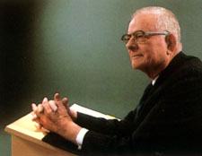
The Quality Gurus – Edward Deming
Quality is “uniformity and dependability”
Focus on SPC and statistical tools
“14 Points” for management
PDCA method
1900-1993
1986

Slide 37
PDCA
Plan for new product development and Production process
Create a prototype, test it and collect data from customer
PLAN
Do
ACT
Check
Fully implemented the new design /act on collected feedback
Analyze the collected data to measure customer satisfaction

Slide 38
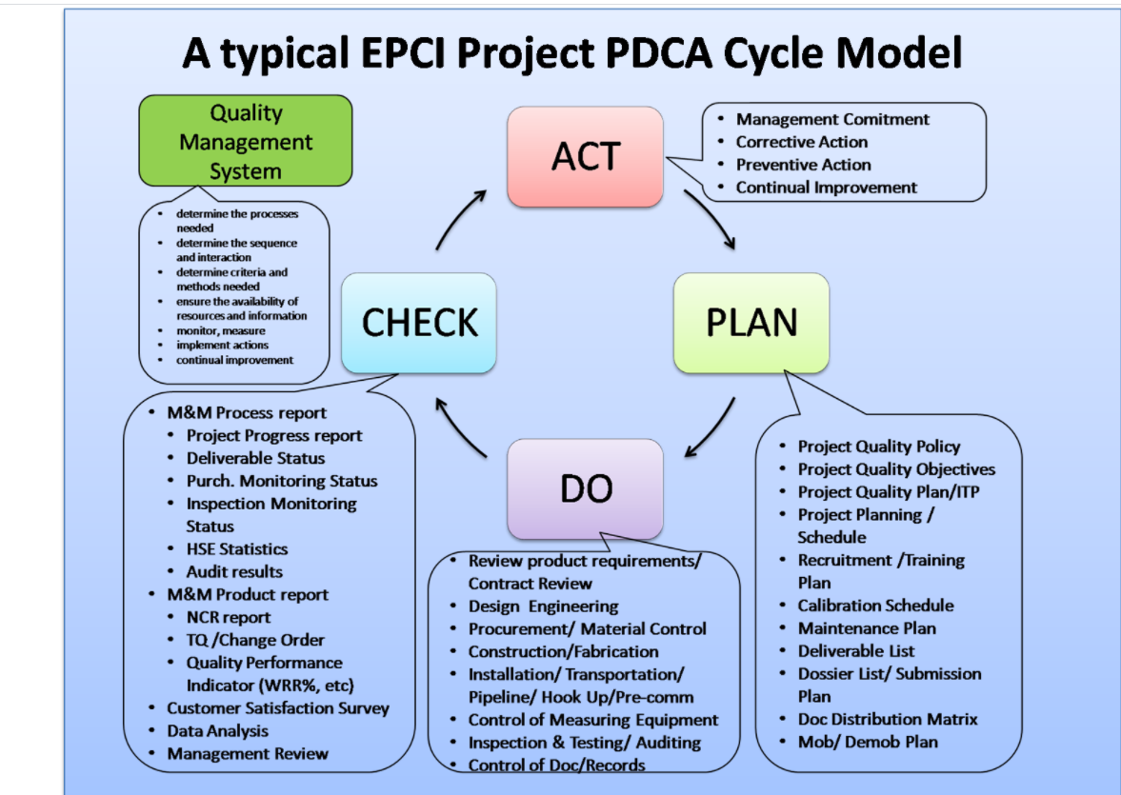
Engineering, Procurement, Construction and Installation

Slide 39
Operation Wrath of God
Fifteen people divided into five squads:
Aleph two trained killers;
Bet two guards who would shadow the Alephs;
Het two agents who would establish cover for the rest of the team by renting hotel rooms, apartments, cars, and so on;
Avin comprising between six and eight agents who formed the backbone of the operation, shadowing targets and establishing an escape route for the Aleph and Bet squads;
Qoph two agents specializing in communications

Slide 40
Deming’s 14 Points
Create constancy of purpose
Adopt philosophy of prevention
Cease mass inspection
Select a few suppliers based on quality
Constantly improve system and workers
Institute worker training
Instill leadership among supervisors

Slide 41
Eliminate fear among employees
Eliminate barriers between departments
Eliminate slogans
Remove numerical quotas
Enhance worker pride
Institute vigorous training and education programs
Develop a commitment from top management to implement above 13 points

Slide 42
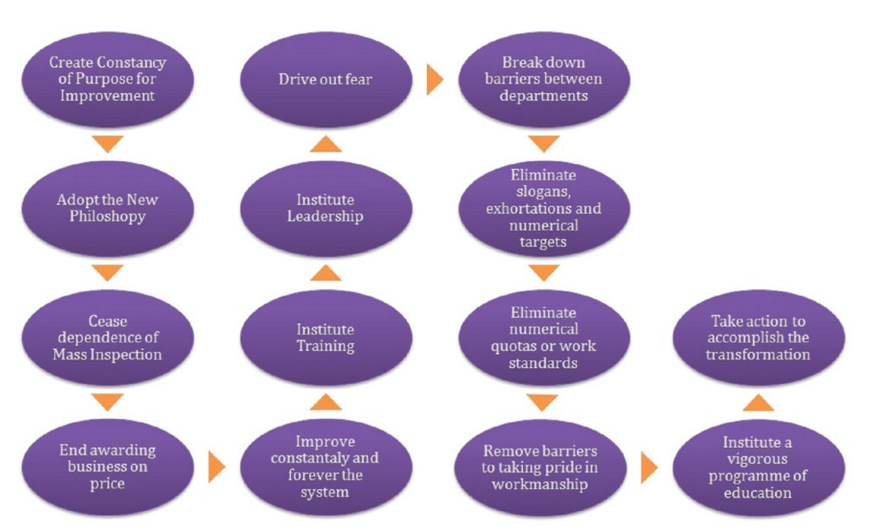

Slide 43

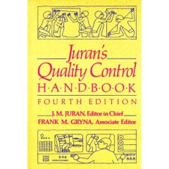
The Quality Gurus – Joseph Juran
Quality is “fitness for use”
Pareto Principle
Cost of Quality
General management approach as well as statistics
1904 - 2008
1951

Slide 44
Cost of Quality
Quality planning
Quality improvement team, education and training
New product review
Cost of Prevention
Cost incurred to prevent poor Quality
2. Cost of Appraisal
Cost incurred to determine the degree of conformance to quality requirement
Inspection, testing, auditing etc
3. Internal failure cost
Scrap, rework, re testing
4. External Failure Cost
Customer Return, Transportation, Warranty Claim

Slide 45

Optimum Cost Policy
Total Cost
Minimum Total Cost
Failure or Appraisal Cost
Prevention cost
Quality of Product

Slide 46
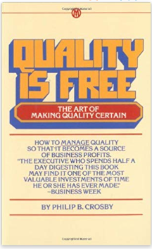

The Quality Gurus – Philip B. Crosby
Philosophies of Quality management
Zero Defects
Quality Management Maturity Grid
1926 - 2001
1979

Slide 47
Quality Management
It is a process that ensures the quality of the product or service throughout its life cycle
Monitoring
Measures
Objective
Control
Testing
Quality Management
Audit
Effectiveness
Analysis
Procedures
Processes
Improvement

Slide 48
Components of Quality Management
Quality Planning | Quality Control
Quality Improvement | Quality Assurance

Slide 49
Quality Planning
Quality Control planning is the first step.
Requirement must be identified.
A criteria need to be set.
Important procedure must be recognized as a part of plan.

Slide 50
Quality Control
Quality control needed to review the quality of product or services.
Inspection and testing is necessary to identify problems and deflects that need correction.

Slide 51
Quality Assurance
Companies need to assure defects and mistakes are avoided in the manufacturing of goods or the deliver of services.
Quality assurance guarantees consistent results.
Quality control focused on providing confidence that quality requirement will be fulfilled

Slide 52
Quality Improvement
There is always a room for improvement.
Through quality improvement, the result can be measured and possible improvement in product and services can be made

Slide 53
Zero Defect
Zero Defects is a management tool aimed at the reduction of defects through prevention.
It is directed at motivating people to prevent mistakes by developing a constant, conscious desire to do their job right the first time
it has been primarily adopted within supply chain wherever large volumes of components are being purchased (common items such as nuts and bolts are good examples)

Slide 54
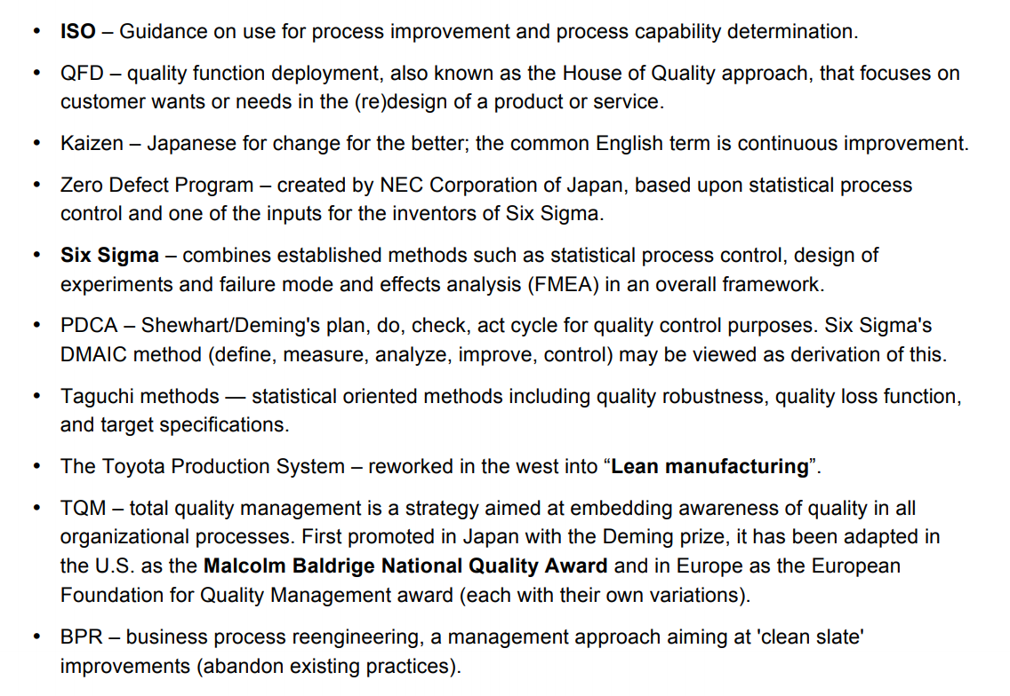
Methodology: Implementing Quality

Slide 55
Methodology: Implementing Quality
ISO (International Organization for Standardization)
ISO-9000
ISO-14000
TQM
Six-Sigma
BPR
Taguchi Method
Kaizen
QFD

Slide 56
Factors Affecting Quality
Men
Machine
Material
Manufacturing Condition
Capability to Invest Money
Product Design
After sale service

Slide 57
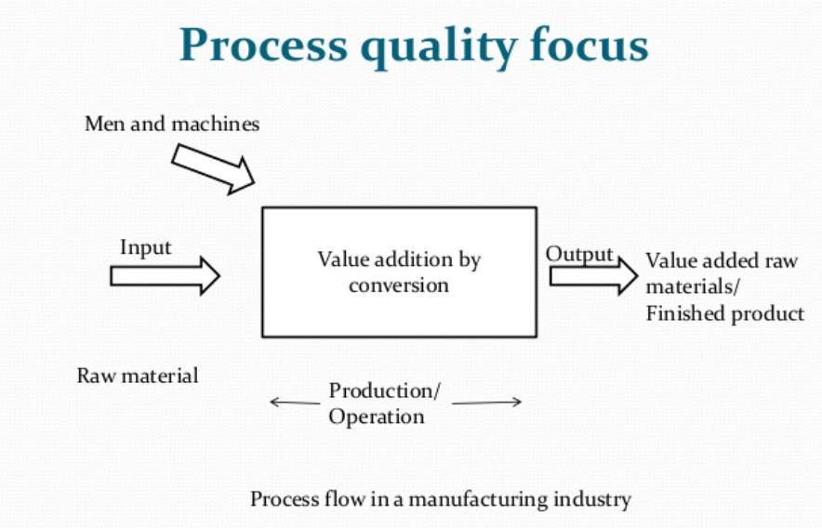

Slide 58
Problem Solving Tools for Quality
Cause-and-Effect Diagrams
Flowcharts
Checklists
Control Charts
Scatter Diagrams
Pareto Analysis
Histograms

Slide 59
Cause-and-Effect Diagrams
Developed by Ishikawa in 1943
Called Fishbone Diagram or Ishikawa diagram
Explore possible root causes of a problem
If process is stable, this diagram helps to decide which causes to investigate for process investigation.

Slide 60
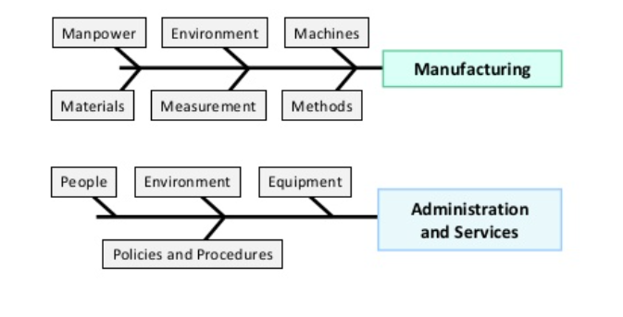
Explore possible root causes of a problem

Slide 61
6Ms are used:
Man
Method
Machines
Materials
Mother of Nature(Environment)
Measurement
Policies
Procedure
Rules
Raw material
Parts
packing
Location
Time
Temperature
Culture

Slide 62
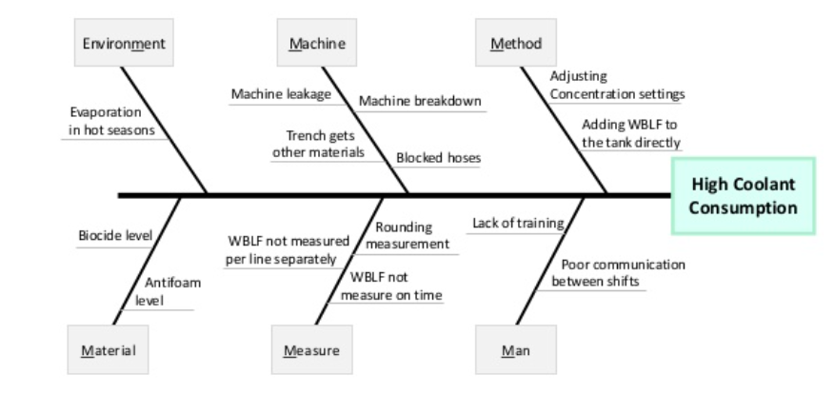
The increased coolant consumption in a factory

Slide 63
A cause and Effect Matrix could be used to prioritize the causes of the problem
Prioritizing and selecting the key causes will minimize the need for more statistical evaluation of inputs that are unlikely to have an impact on the output

Slide 64
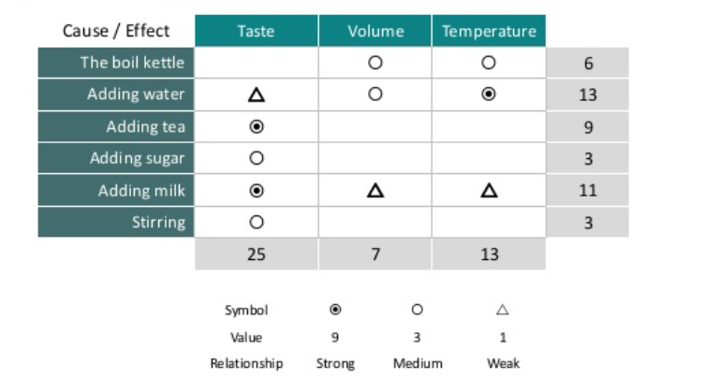
Making Tea Cause effect Matrix

Slide 65
Flow chart
Used to document the sequence of events in a process.
A detailed flowchart can identify bottlenecks, redundant steps, non-value added activities.
Has purchase order for payment received
No
Wait for purchase order
Order Received
Yes
Can order quantity be met from stock?
No
Produce as per demand
Yes
Check due date & lead time & set shipment date
Package Product
Ship product
Received by customer
Flow chart for incoming order processing

Slide 66
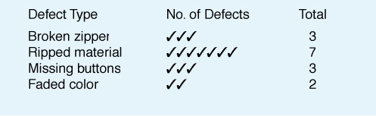
Checklists
It facilitates systematic record keeping or data collection
Observations are recorded as they happen, which reveals pattern or trends.
Simple data check-off sheet designed to identify type of quality problems at each work station; per shift, per machine, per operator

Slide 67
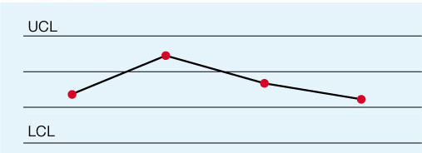
Control Charts
Used to monitor & control a process on an ongoing basis.
Plots a selected quality characteristics as a function of sample number.
Distinguish special causes of variation from common causes of variation.
Centre line represents the average value of characteristics being plotted. The UCL and LCL are calculated limits used to show when process is in or out of control
Quality Characteristics
CL
Sample no

Slide 68
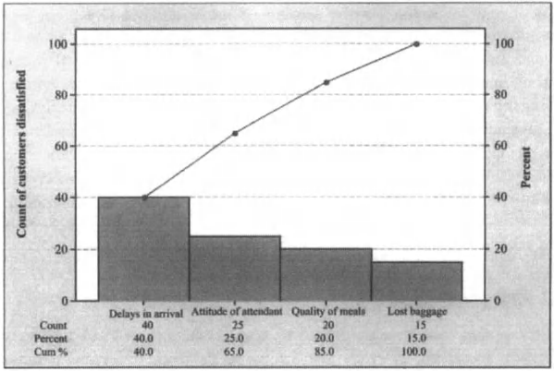
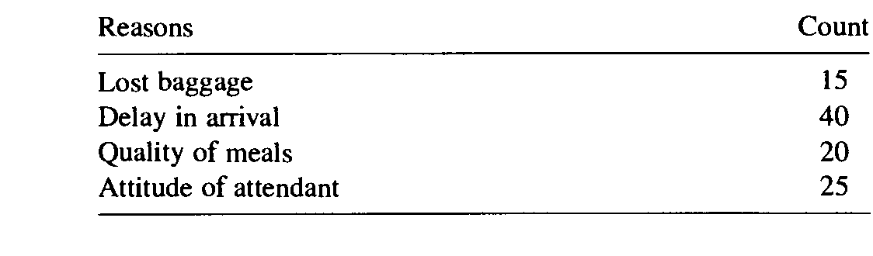
Pareto Analysis
Identify the critical areas that deserves immediate action.
Technique that displays the degree of importance for each element
Named after the 19th century Italian economist Alfredo Pareto.
Often called the 80-20 Rule (Vital few and trivial many)
Principle is that quality problems are the result of only a few problems e.g. 80% of the problems caused by 20% of causes

Slide 69
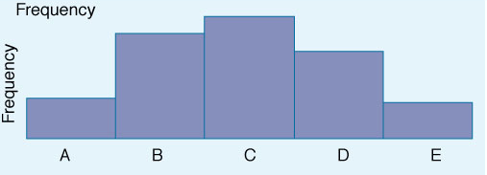
Histograms
Displays large amount of data that are difficult to interpret
Histogram reveals whether the process is centered around a target value, degree of variation in the data and whether data meet specification.
Help in identifying process capability relative to customer requirements
A chart that shows the frequency distribution of observed values of a variable like service time at a bank drive-up window.

Slide 70
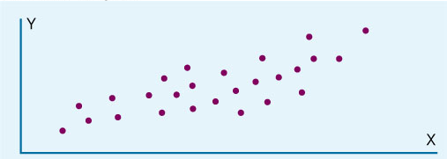
Scatter Diagrams
A graph that shows how two variables are related to one another
Often used a s follow-ups to a cause & effect analysis
Sales
Advertisement

Slide 71
